Slide 1
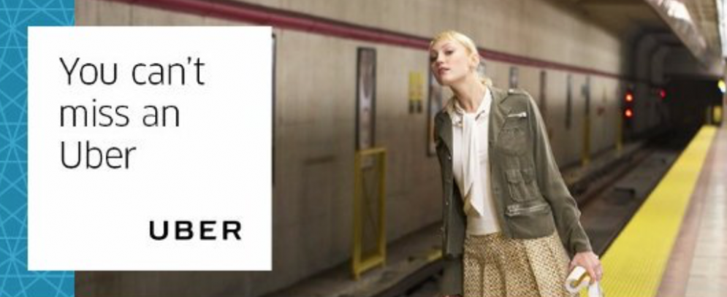
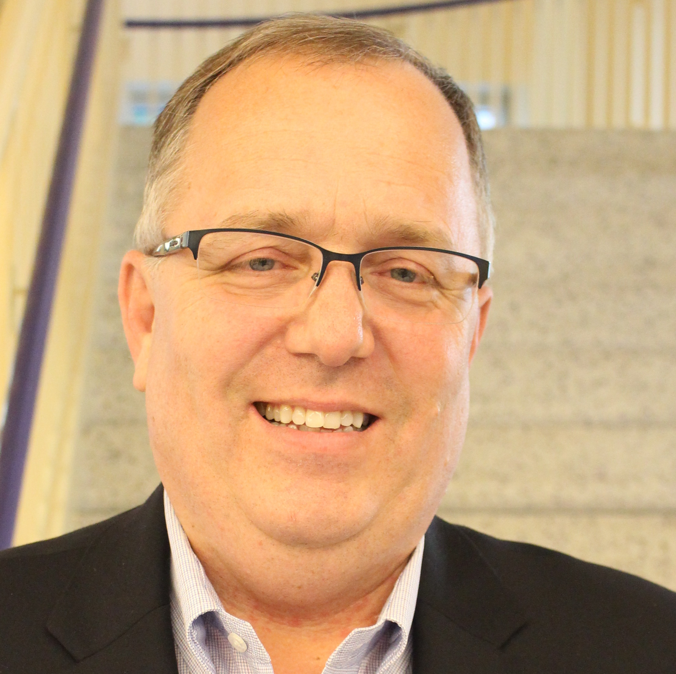
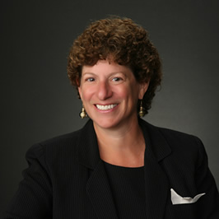
How to Uber-ize Public Transit
to Save It
L-r:
Doug Kaufman Michael Russel
Marlene Connor
SXSW
Paul Mackie, Mobility Lab

Slide 2
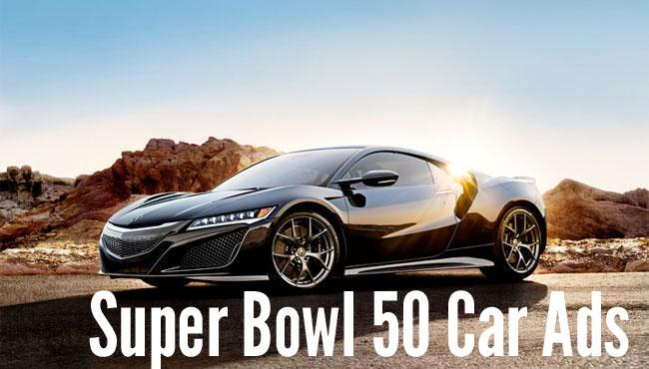
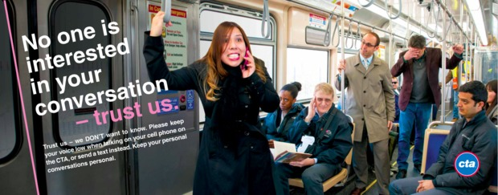
A mismatch in messaging & confidence?

Slide 3
Can public & private partners help on-demand and “fixed” work together?

Slide 4
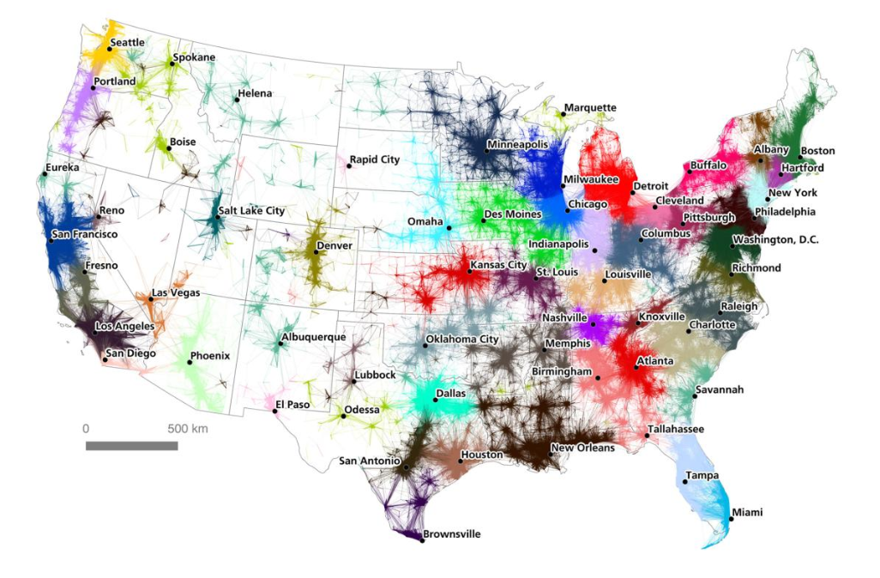
How do we travel in our growing “Commuting Megaregions?”

Slide 5
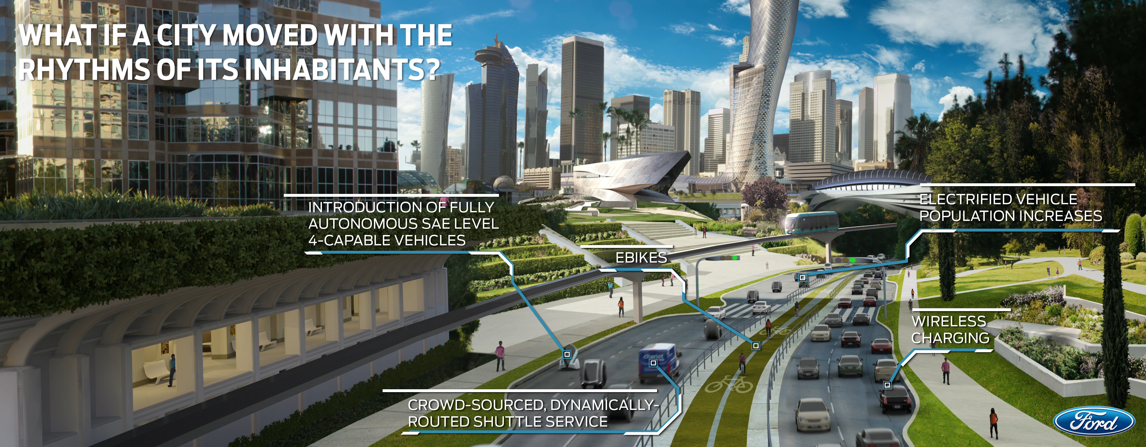
Transit needs to better serve as the core for
all these other nodes.

Slide 6
Tech can help connect all the travel nodes.

Slide 7
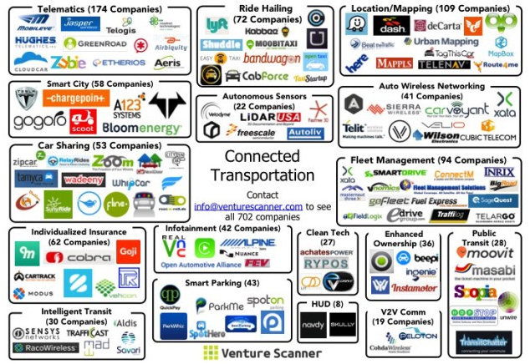
The expanding world of connected-transportation choices.

Slide 8
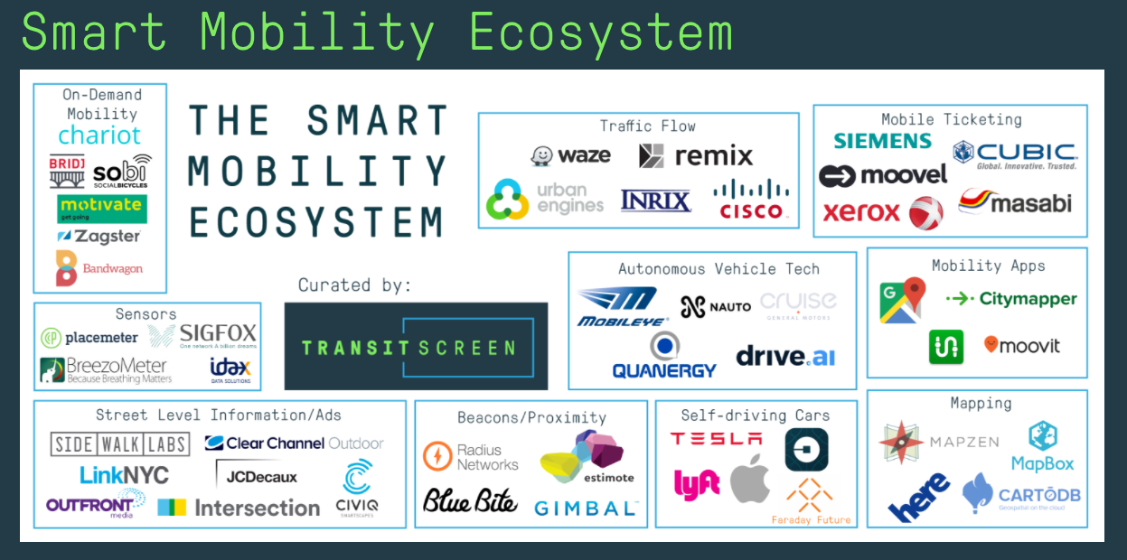
Cities have to figure out who to partner with and which tech to use.

Slide 9
Which ride-hailing systems should be used?
How do they align with transit?

Slide 10
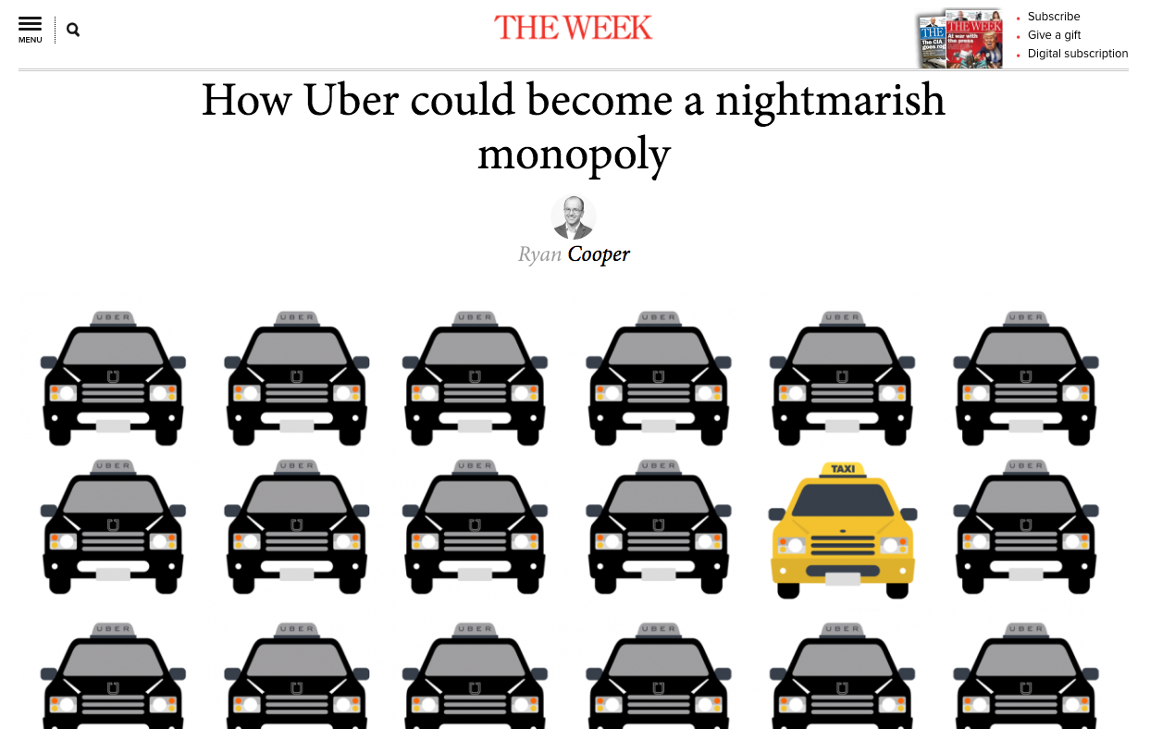
Or is the question “How do we transit-ize Uber to save it?

Slide 11
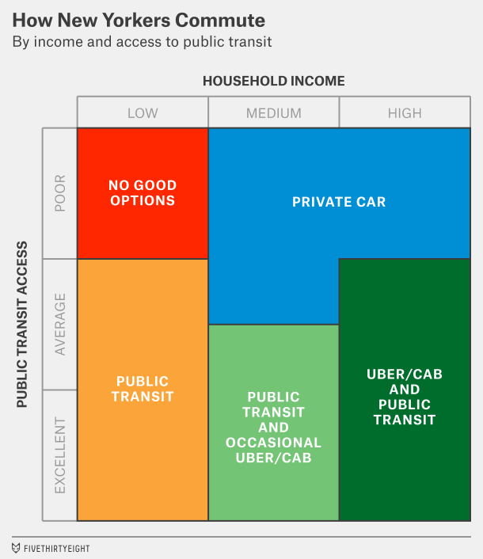
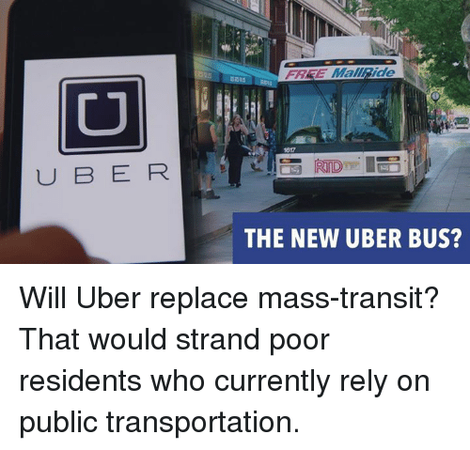
A better question? How do we Uber-ize transit to make it better for everybody?

